Slide 1
Making Light.GuardClauses Faster
Introduction to Performance Optimization and BenchmarkDotNet

Slide 2
Table of Contents
What is Light.GuardClauses?
How was it optimized for version 4 and onwards?
How can BenchmarkDotnet be used to write automated performance benchmarks?
How does BenchmarkDotnet work internally?
Got questions? Just ask them!

Slide 3

About Me
Kenny Pflug
Senior Software Developer at Synnotech
PhD student at University of Regensburg
Twitter: @feO2x
GitHub: feO2x
YouTube: youtube.com/c/kennypflug

Slide 4

What is Light.GuardClauses?
Live Demo

Slide 5
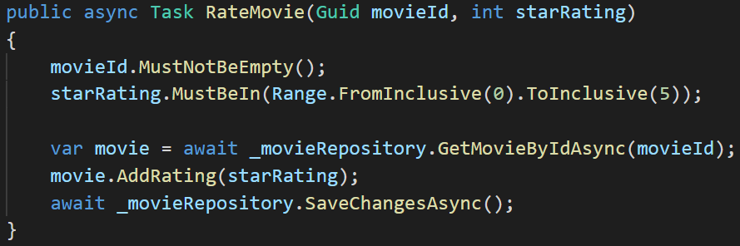
GUIDs and Ranges

Slide 6
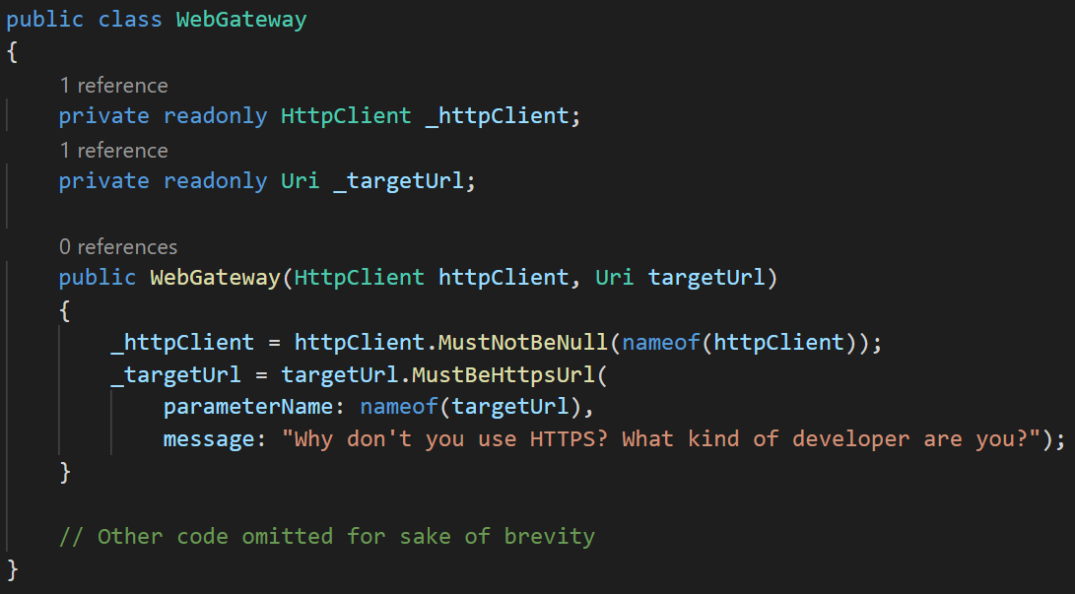
URIs and custom messages

Slide 7
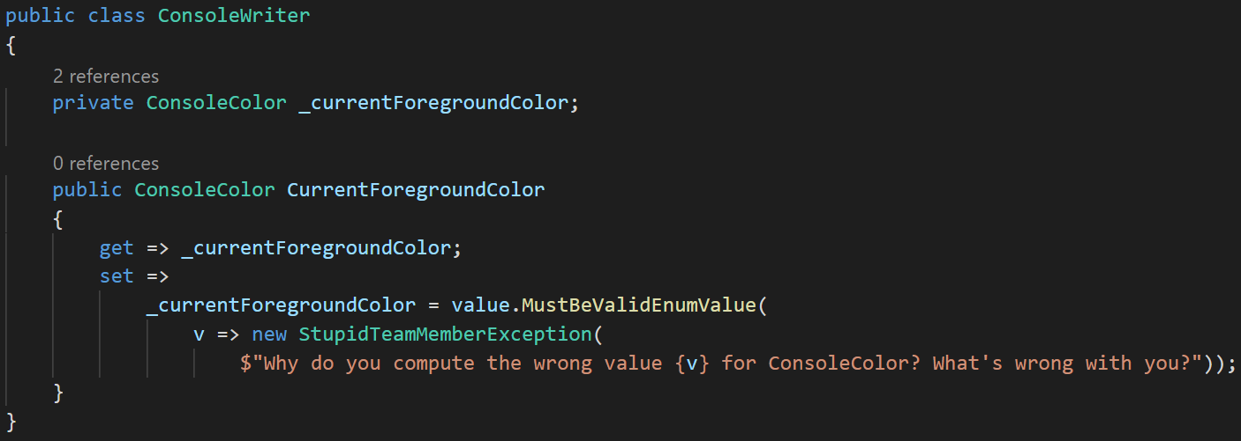
Custom Exceptions

Slide 8
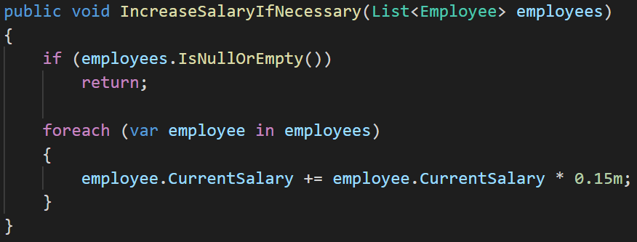
Boolean Assertions

Slide 9
What is Light.GuardClauses?
Light.GuardClauses provides Extension Methods for validating parameters
Support for
.NET Standard 2.0 and 1.0
.NET 4.5, .NET 4.0, .NET 3.5, .NET 3.5 Compact Framework
Silverlight 5
Supports ReSharper Contract Annotations
Available as a NuGet Package or Single-Source-File

Slide 10
Let’s Optimize an Assertion

Slide 11
The time scale
Nanoseconds (ns) 10⁻⁹ to 10⁻⁶
Microseconds (µs) 10⁻⁶ to 10⁻³
Milliseconds (ms) 10⁻³ to 0
Seconds (s)

Slide 12
The overall goal
Be as fast as or faster than an imperative version of the assertion would be!

Slide 13
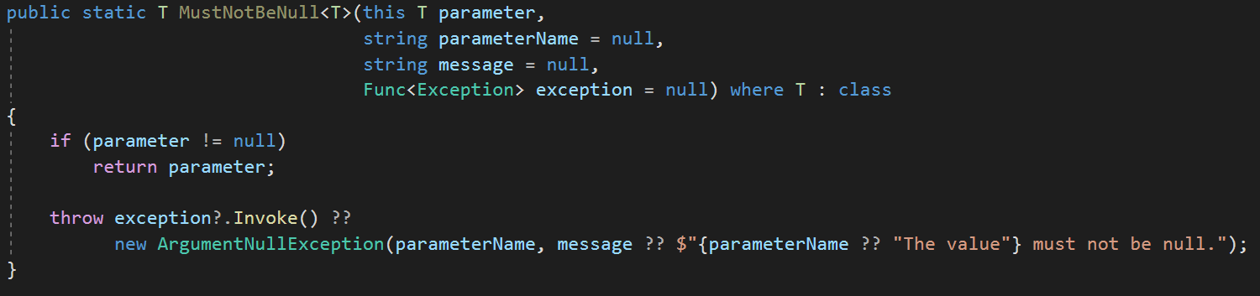
MustNotBeNull – Light.GuardClauses 3.5
Benchmark | Mean .NET Core 3.1 | Mean .NET 4.8
LG v3.5 | ~2.5ns | ~2.3ns

Slide 14
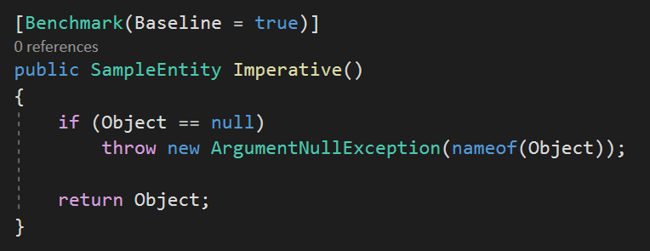
MustNotBeNull – Imperative Code
Benchmark | Mean .NET Core 3.1 | Mean .NET 4.8
LG v3.5 | ~2.5ns | ~2.3ns
Imperative | ~0.4ns | 0?

Slide 15
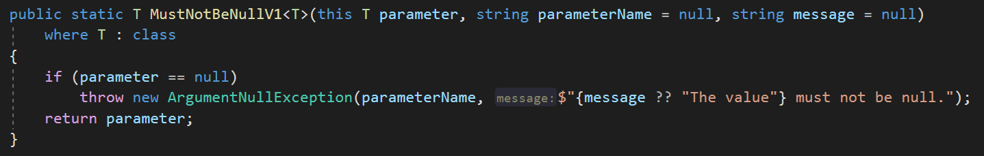
MustNotBeNull – Simple Implementation
Benchmark | Mean .NET Core 3.1 | Mean .NET 4.8
LG v3.5 | ~2.5ns | ~2.3ns
Imperative | ~0.4ns | 0?
Simple | ~1.5ns | ~0.9ns

Slide 16
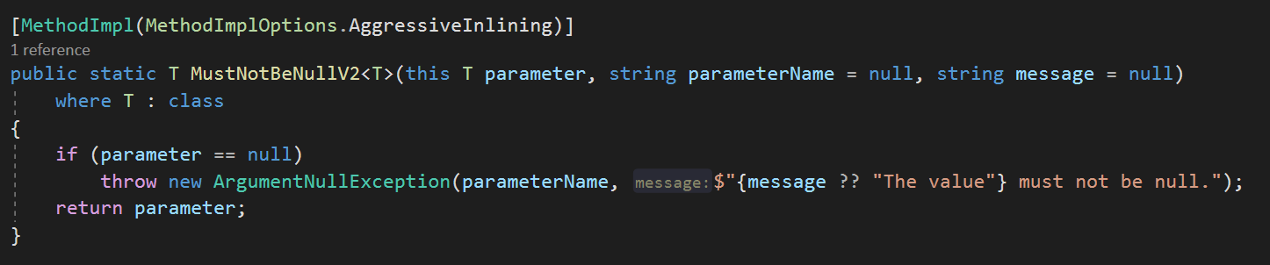
MustNotBeNull – Aggressive Inlining
Benchmark | Mean .NET Core 3.1 | Mean .NET 4.8
LG v3.5 | ~2.5ns | ~2.3ns
Imperative | ~0.4ns | 0?
Simple | ~1.5ns | ~0.9ns
Aggressive Inlining | ~0.2ns | ~0.1ns

Slide 17
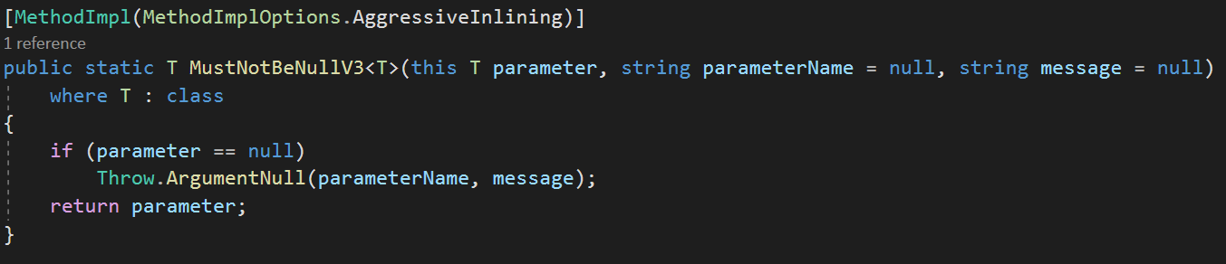
External Throw Call
Benchmark | Mean .NET Core 3.1 | Mean .NET 4.8
LG v3.5 | ~2.5ns | ~2.3ns
Imperative | ~0.4ns | 0?
Simple | ~1.5ns | ~0.9ns
Aggressive Inlining | ~0.2ns | ~0.1ns
External Throw Call | ~0.3ns | ~0.05ns

Slide 18
All Results in One Chart

Slide 19
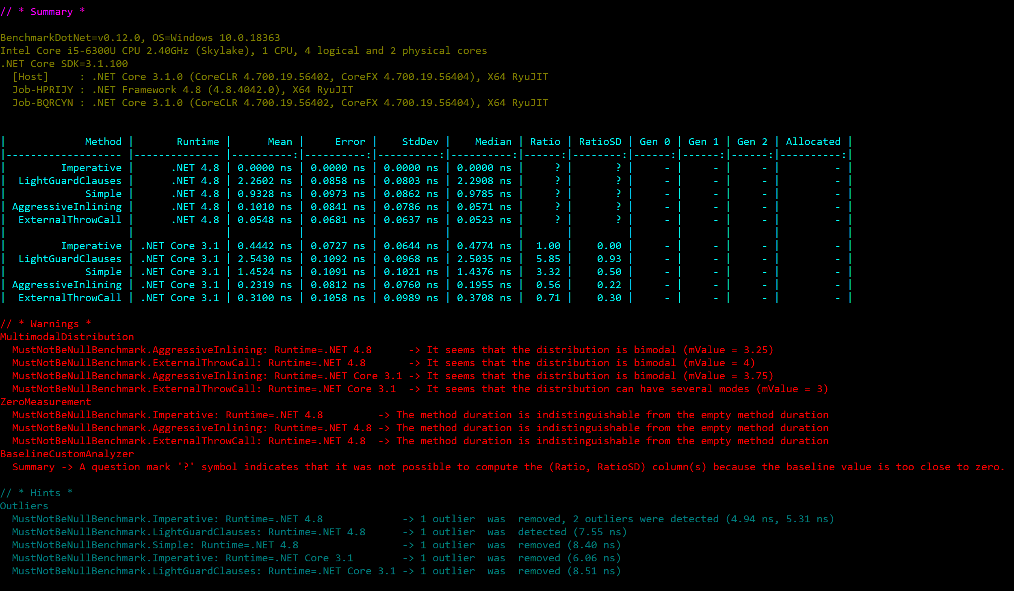
The exact results

Slide 20
Let’s Take a Closer Look at the Exact Results

Slide 21
It Hasn’t Always Been This Way

Slide 22
Performance Results of MustNotBeNull (December 2018)

Slide 23
Performance Results of MustNotBeNull (May 2019)

Slide 24

Performance Consultant for OSS
Federico Andres Lois

Slide 25
How Does BenchmarkDotNet Work Internally?
Live Demo

Slide 26
How Does BenchmarkDotNet Execute Performance Measurements?
Benchmark 1
Runtime .NET
Host-Prozess
Benchmark 1
Runtime .NET Core
Benchmark 2
…

Slide 27
Steps of a Single Benchmark
Pilot – Check how many operations should be executed
Overhead – Determine the overhead of BenchmarkDotNet
Actual Warmup – Call the target method several times to fill the cache
Actual Workload – Capture actual performance results
Result – Average Actual Workload - Average Overhead
Additional runs (e.g. for Memory Diagnosis) might be executed.

Slide 28


BenchmarkDotNet Maintainers
Andrey Akinshin
Adam Sitnik

Slide 29
Some Additional Performance Results

Slide 30
MustBeGreaterThan (December 2019)

Slide 31
MustBeGreaterThan (May 2019)

Slide 32
MustBeGreaterThan (December 2018)

Slide 33
IsValidEnumValue (December 2019)
48 Bytes
24 Bytes

Slide 34
IsValidEnumValue (May 2019)
48 Bytes
24 Bytes

Slide 35
IsValidEnumValue (December 2018)
48 Bytes
24 Bytes
48 B
48 B

Slide 36
IsSubstringOf (December 2019)

Slide 37
IsSubstringOf (May 2019)

Slide 38
IsSubstringOf (December 2018)

Slide 39
General Rules for Performance Optimization

Slide 40
Every step I take…
Eliminate unnecessary execution steps
Clean up your memory – do not allocate in performance-critical paths of your code
Write code optimized for your CPU cache
Can you incorporate multi-threading?
Optimize for CPU instruction set
Have a quantifiable performance goal!

Slide 41
The JIT Compiler is most important
Roslyn
CSC
CLR JIT
.cs Source Files
DLL (MSIL)
Machine Instructions

Slide 42
Typical Modified Harvard Architecture
CPU with 4 cores
CU
ALU
CU
ALU
CU
ALU
CU
ALU
RAM
GPU
PCI-E
Memory Bus
L1 D
L1 I
L1 D
L1 I
L1 D
L1 I
L1 D
L1 I
L2 Cache
L2 Cache
L2 Cache
L2 Cache
L3 Cache
DMI
Platform Controller Hub
USB
SATA
PCI

Slide 43
Important Access Latencies

Slide 44
What to read?

Slide 45
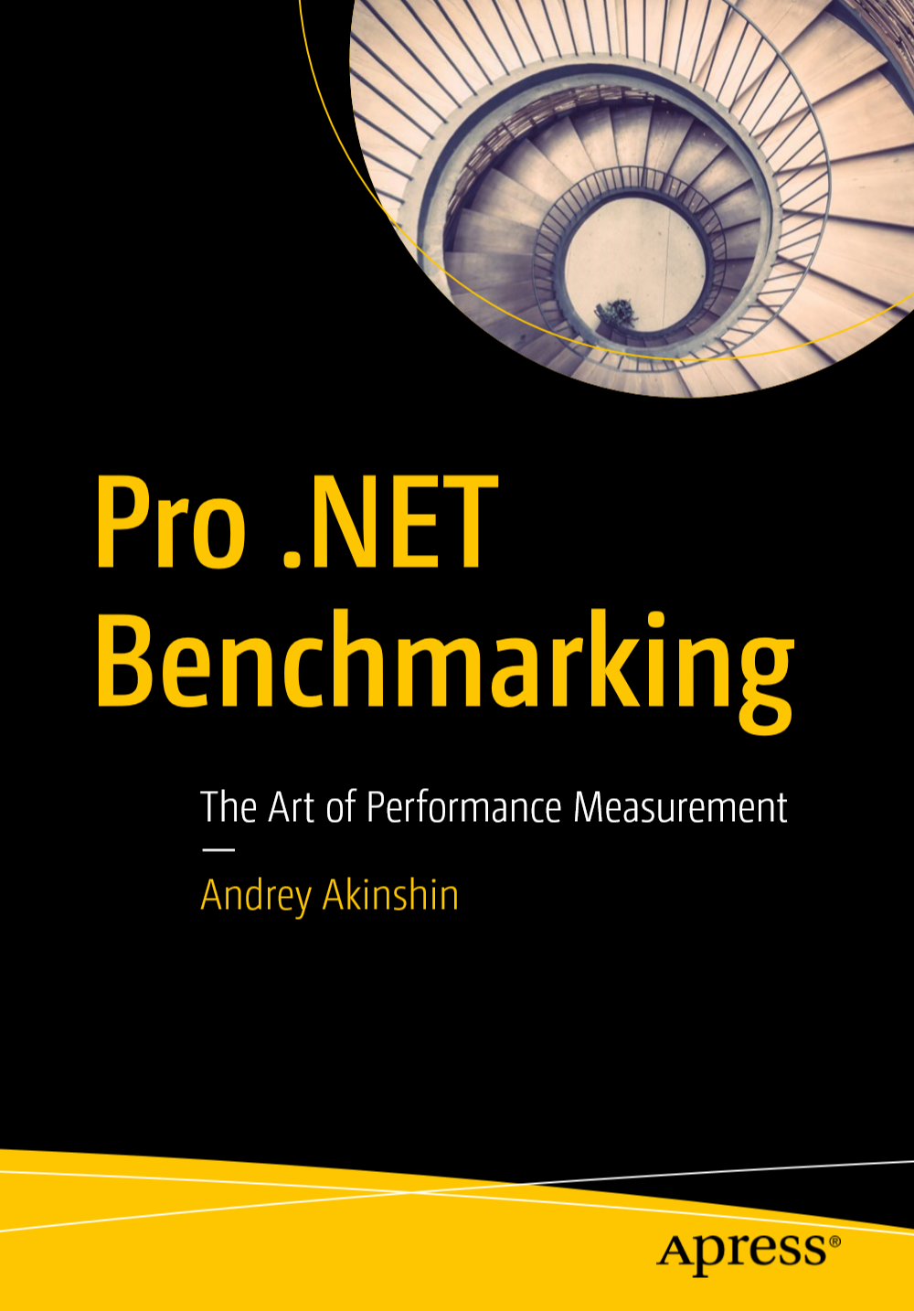
Pro .NET Benchmarking

Slide 46
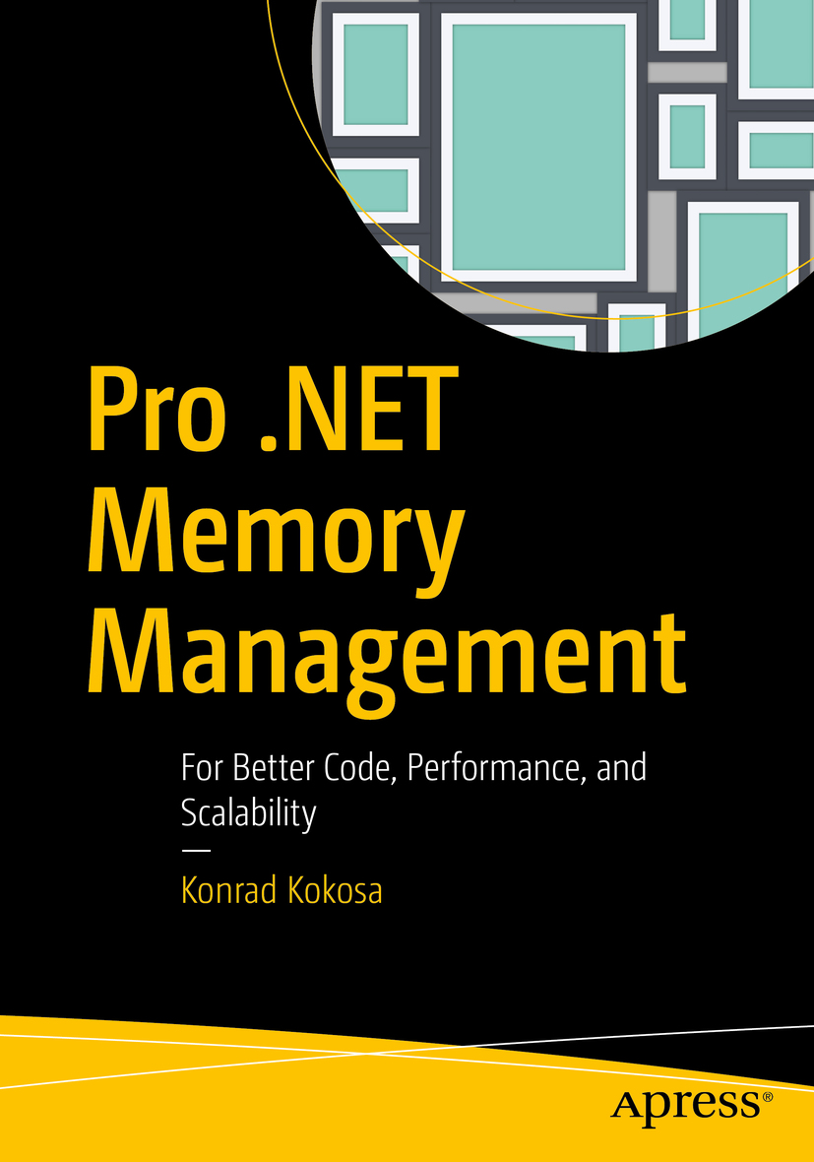
Pro .NET Memory Management

Slide 47
Bibliography
[1] – Pro .NET Memory Management – Konrad Kokosa, Apress Media, 2018
[2] – Writing High-Performance .NET Code – Ben Watson, 2018
[3] – Benchmark.NET
[4] – Awesome .NET Performance – Adam Sitnik, GitHub

Slide 48
Thank you!
Slides and code are available at
https://github.com/feO2x/DNDGGraz.PerfOptimization

